Slide 1
Summer School Overview
Day 0: R bootcamp
Day 1: Workflow, Google App Engine
Day 2: Online Experiments
Day 3: Data wrangling, visualization
Day 4: Statistics, Probabilistic models
Day 5: Experience sampling

Slide 2
Packages and programs
Please install the lme4, brms, tidybayes and BayesFactor packages in R, along with JAGS (see link on resources page of website)

Slide 3
Announcements

Slide 4
Day 4 materials
Update your copy of the chdss2019_content repository
(type git pull at the terminal when working directory is Desktop/chdss2019_content)
Open chdss2019_content.Rproj

Slide 5
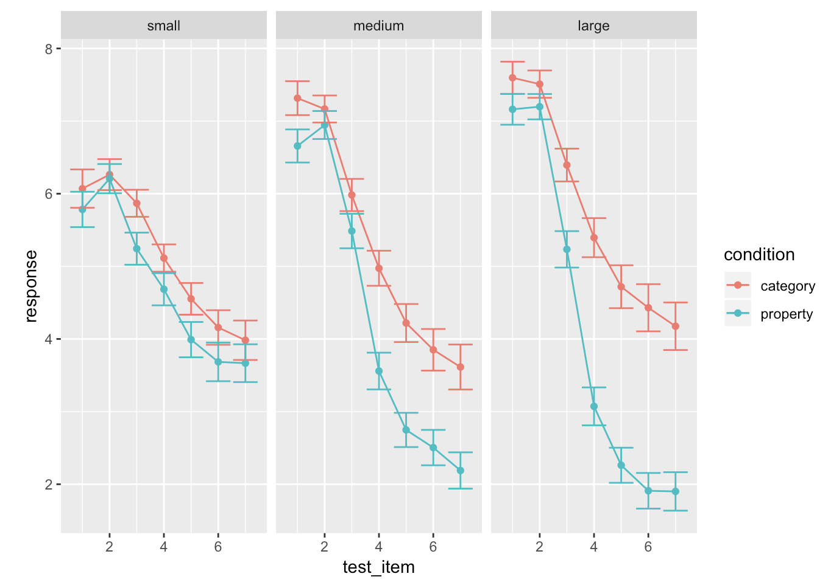
Goals
Introduce some statistical concepts, including Bayesian approaches and mixed effects models
Work towards a statistical analysis of the sampling frames data

Slide 6
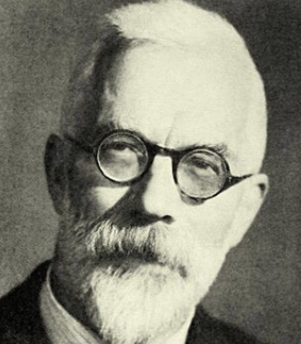
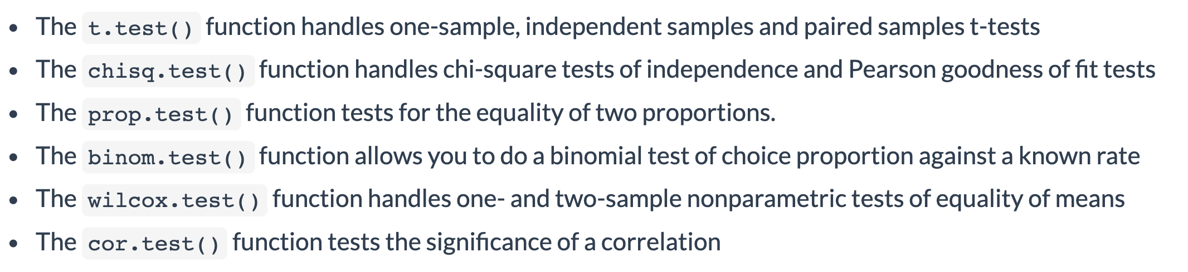
Classical tests

Slide 7
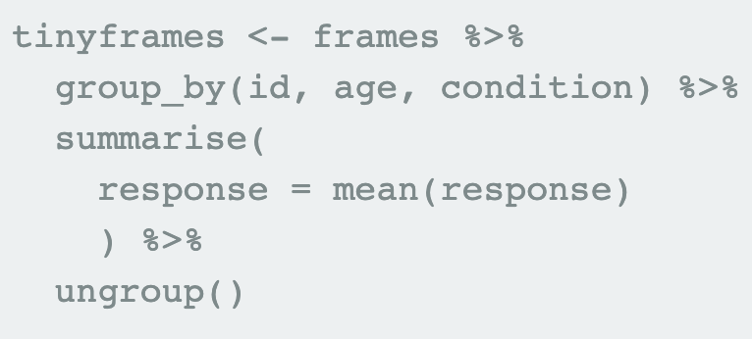
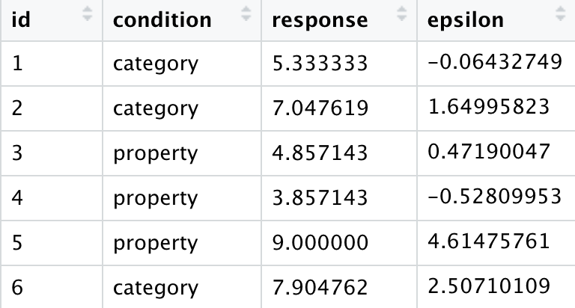
tinyframes data

Slide 8
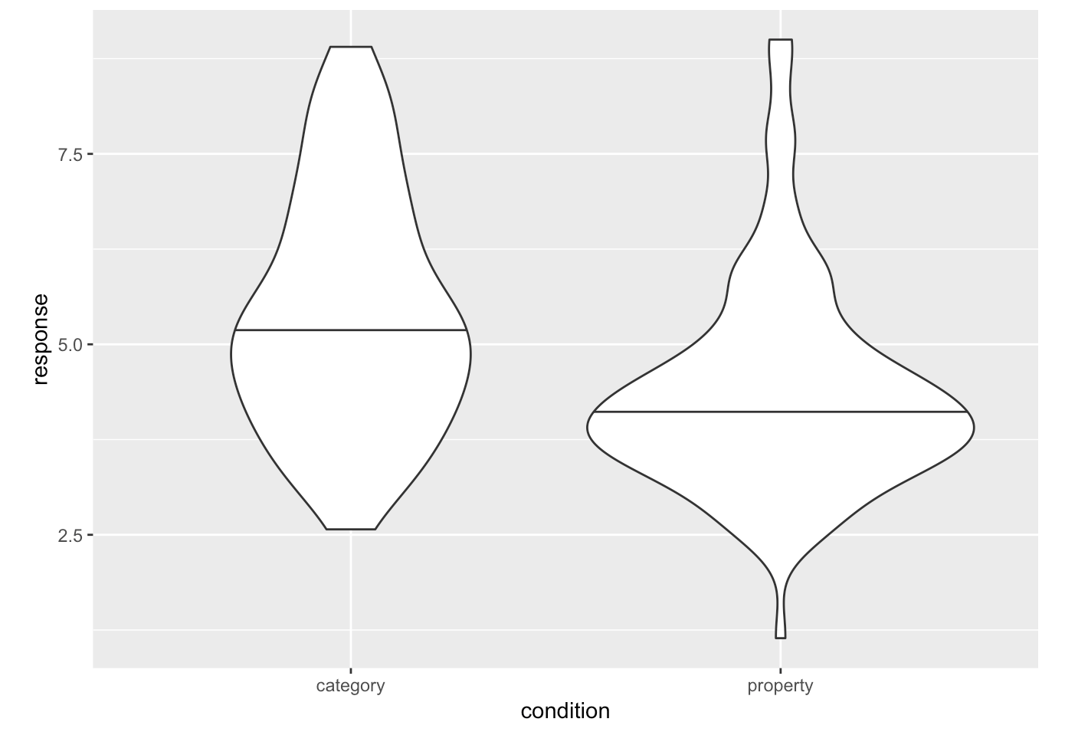
tinyframes data

Slide 9
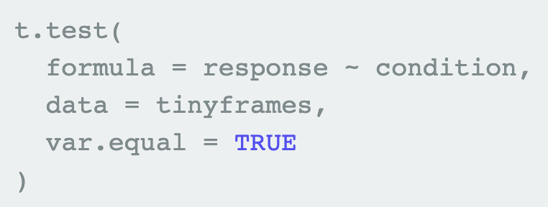
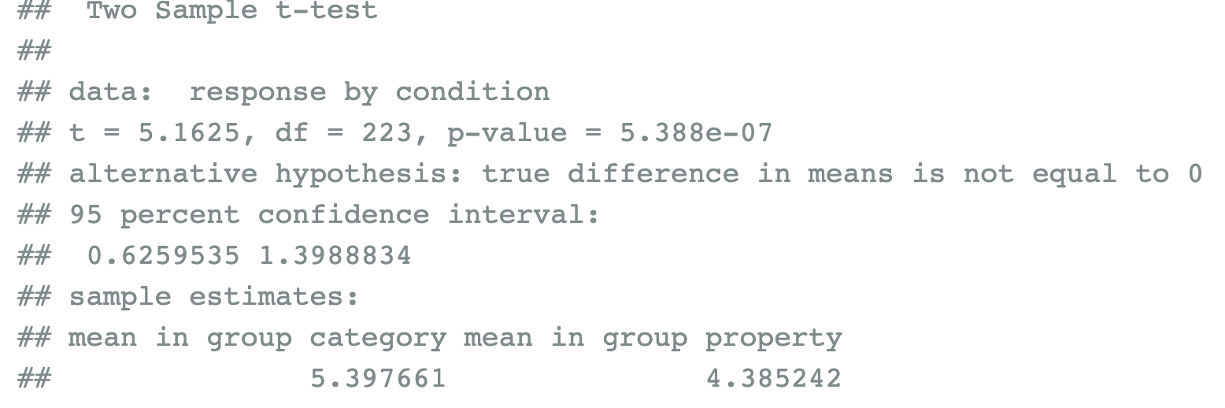
t-test

Slide 10
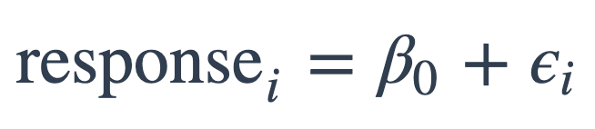
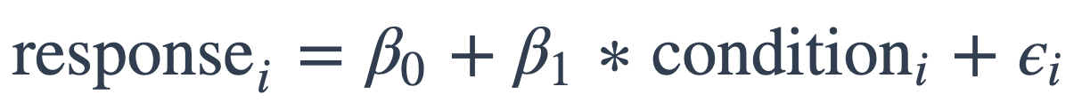
From a t-test to linear models
mod1:
mod2:

Slide 11
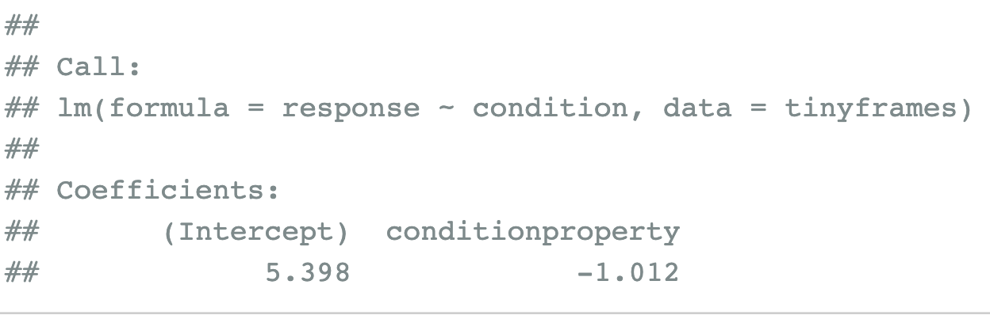
From a t-test to linear models
mod1:
mod2:

Slide 12
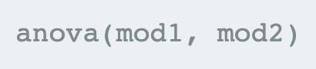
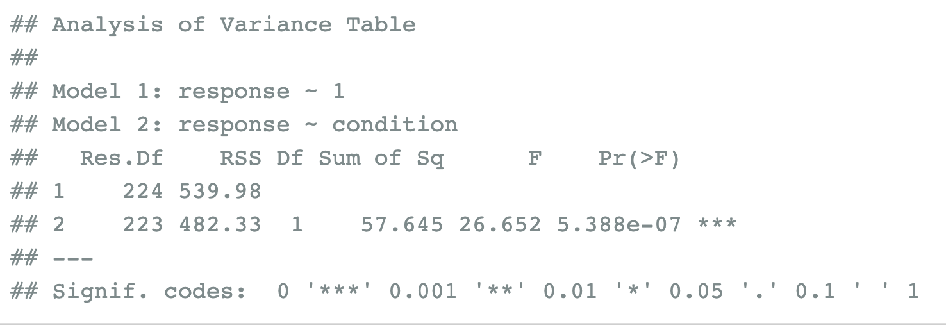
ANOVA for model comparison
mod1:
mod2:

Slide 13
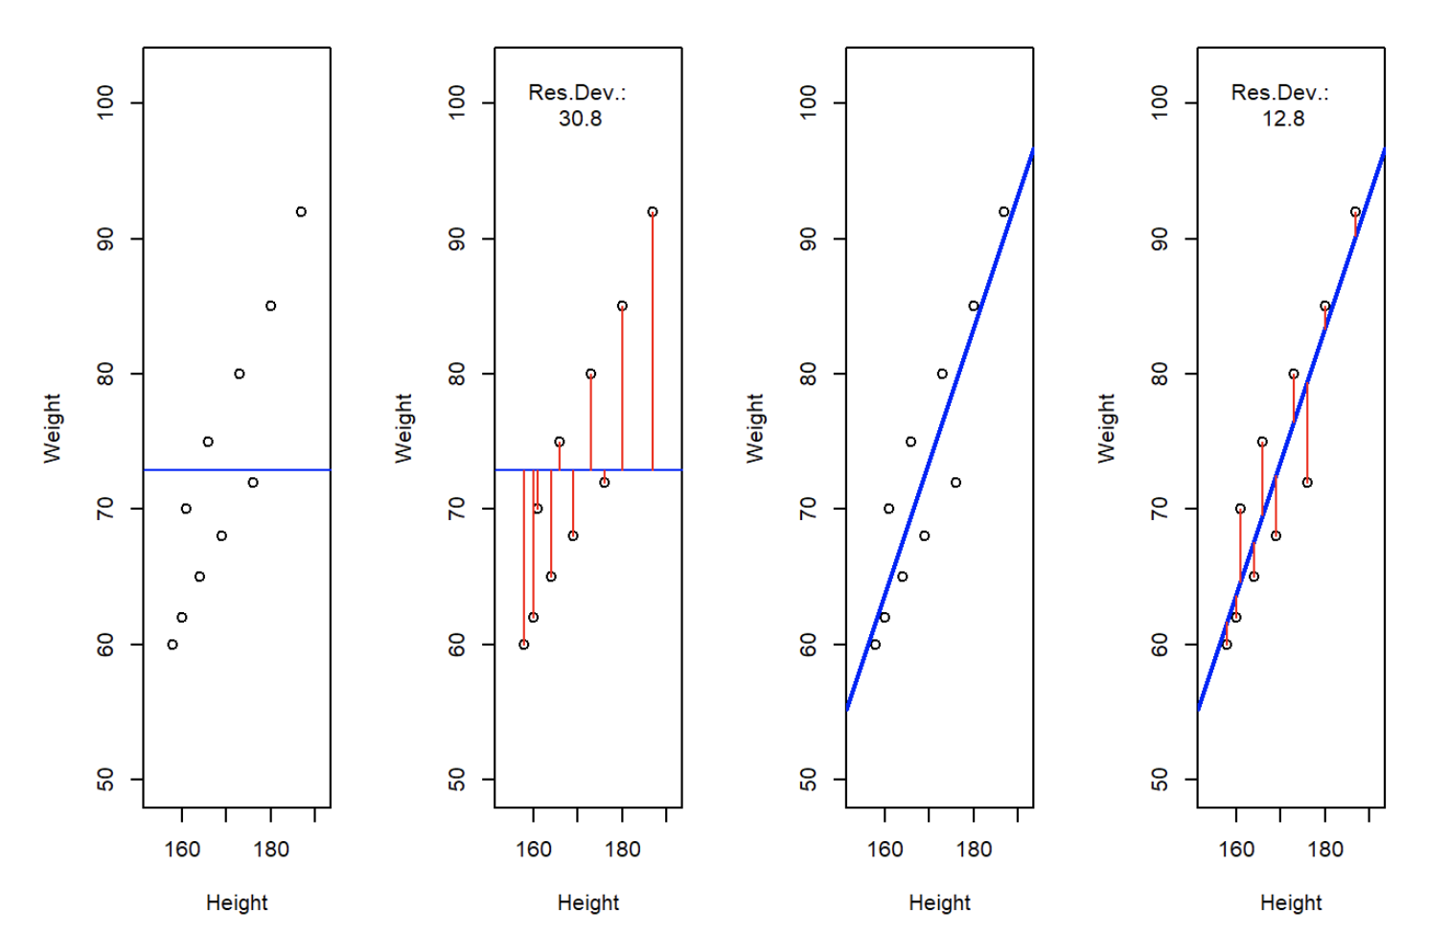
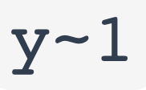
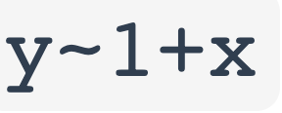
Least squares regression

Slide 14
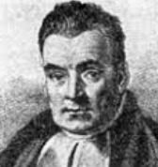
Coughing patient
d: Jen is coughing
h₁: Jen has a cold h₂: Jen has emphysema h₃: Jen has a stomach upset
Posterior
probability
Evidence
(Likelihood)
Prior
knowledge
P(h|d) = P(d|h) P(h)
P(d)
Notes:
Sketch bar graphs on the board

Slide 15
Coughing patient
d: Jen is coughing
h₁: Jen has a cold h₂: Jen has emphysema h₃: Jen has a stomach upset
Posterior
probability
Evidence
(Likelihood)
Prior
knowledge
P(h|d) α P(d|h) P(h)
Notes:
Sketch bar graphs on the board

Slide 16
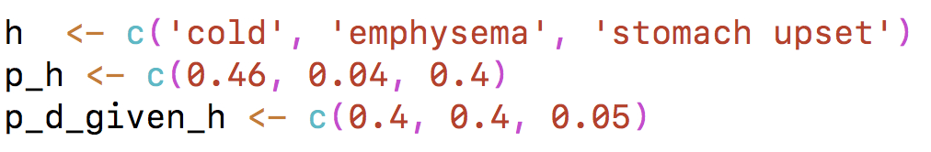
Specifying prior and likelihood

Slide 17
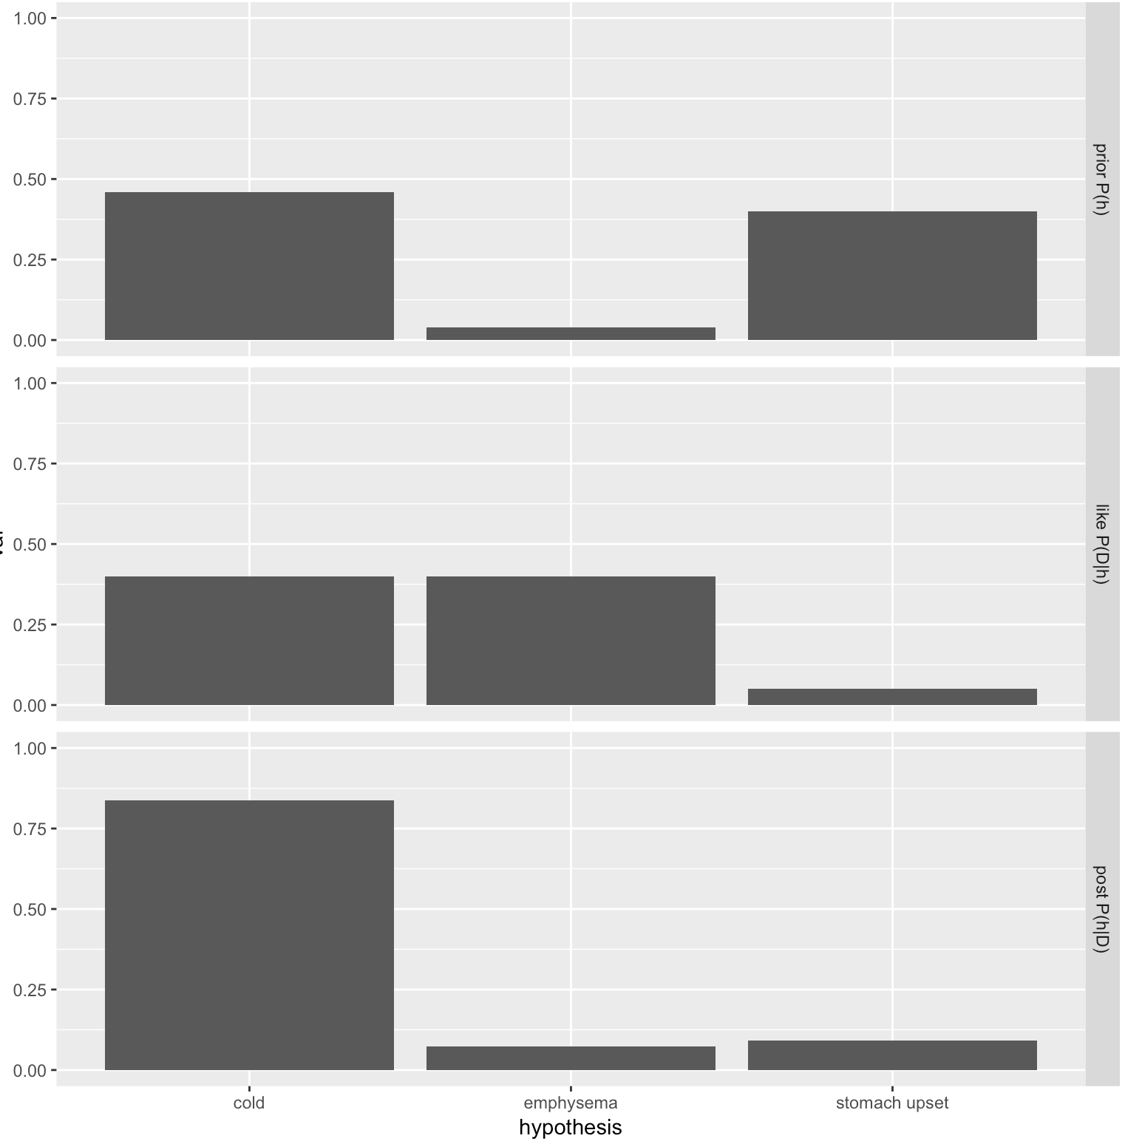
prior
likelihood
posterior

Slide 18
Exercise: Coughing patient

Slide 19
Bayesian inference
Two distinct applications:
Bayesian Data analysis
Bayesian cognitive models

Slide 20
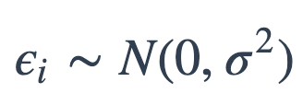
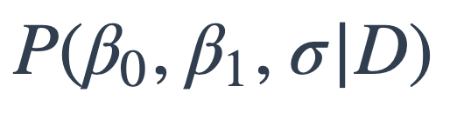
Bayesian regression
M₁:
M₂:
Both models assume
Fitting M₂: compute
where D is the observed data

Slide 21

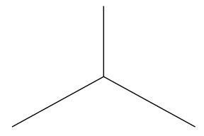

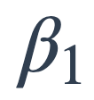
Bayesian regression
prior
likelihood
posterior

Slide 22

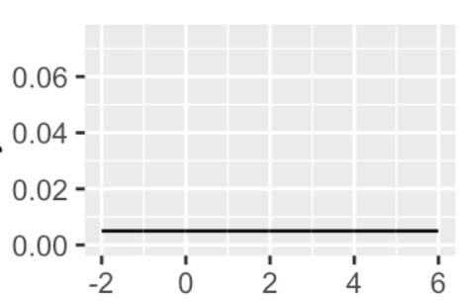
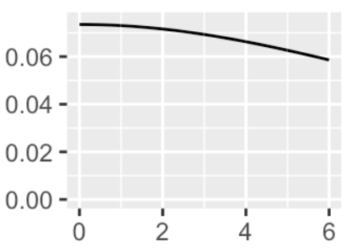
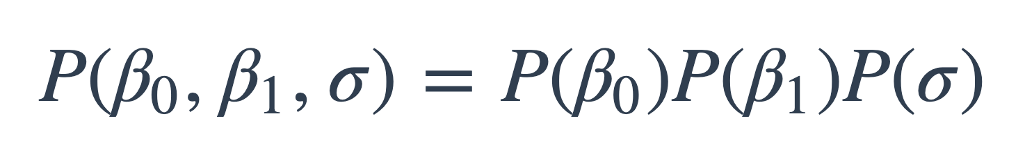
Bayesian inference
prior
Assume

Slide 23
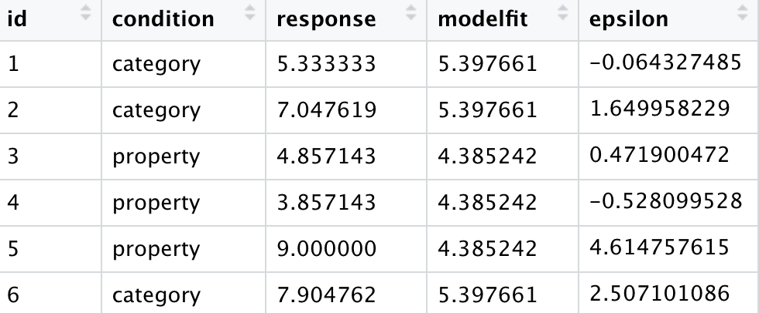
Bayesian inference
likelihood

Slide 24
Bayesian inference
likelihood

Slide 25
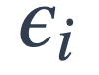
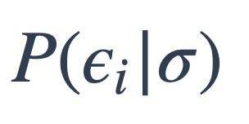
Bayesian inference
likelihood
…

Slide 26
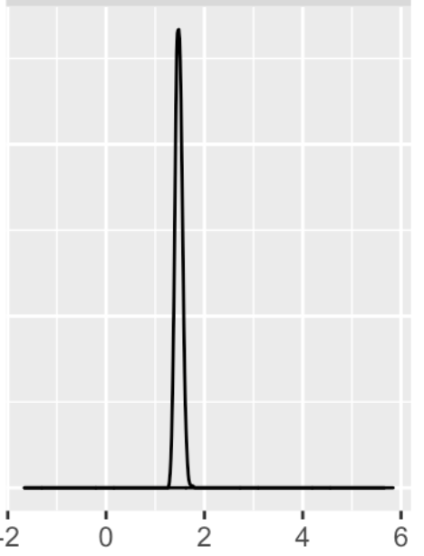
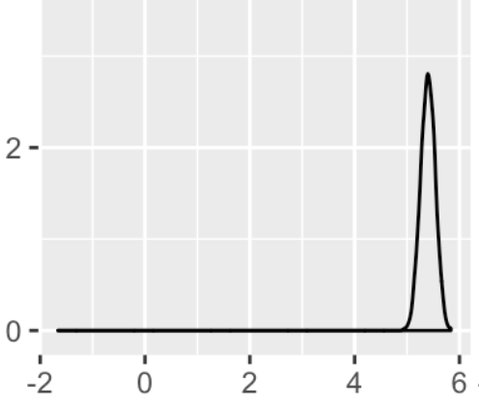
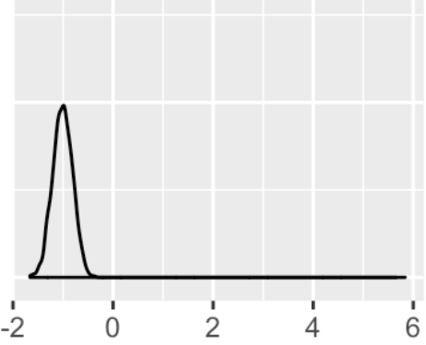
Bayesian inference
prior
posterior

Slide 27
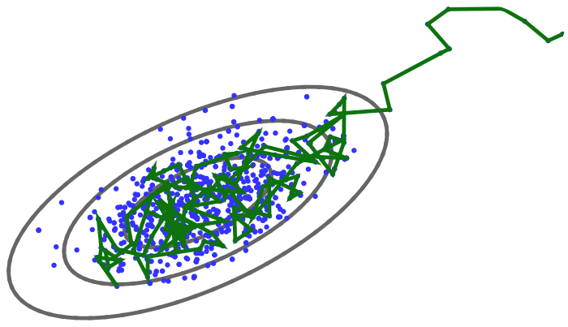
Markov-Chain Monte Carlo (MCMC) methods

Slide 28
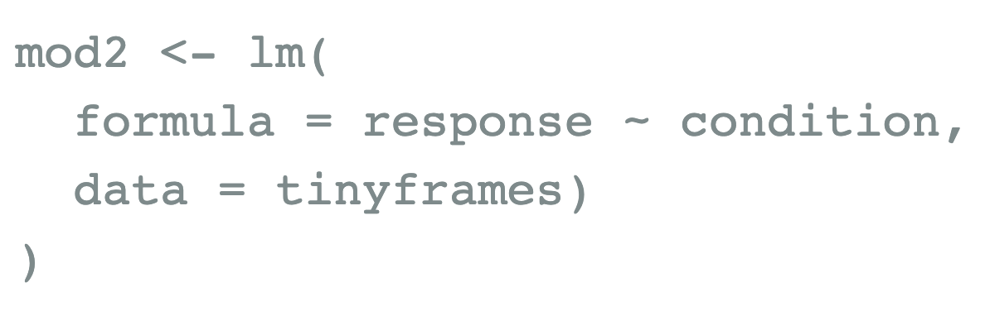
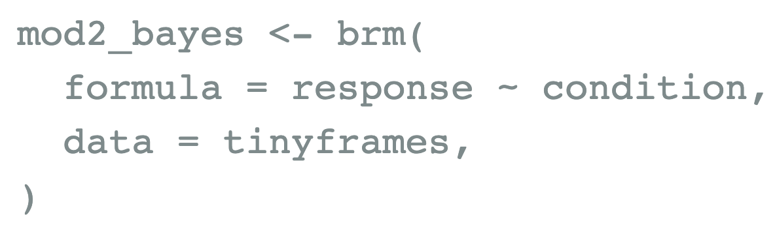
Regression
Least-squares:
Bayesian:

Slide 29
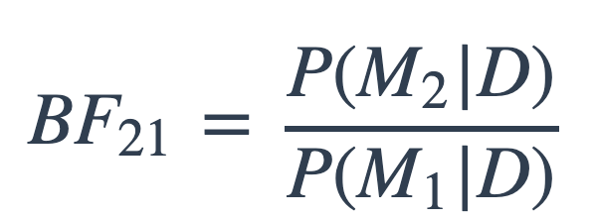
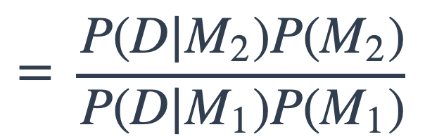
Bayes factors for model comparison
M₁:
M₂:

Slide 30
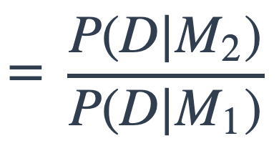
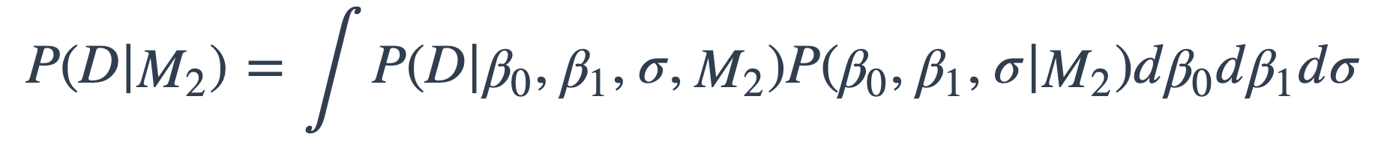
Bayes factors for model comparison
M₁:
M₂:

Slide 31
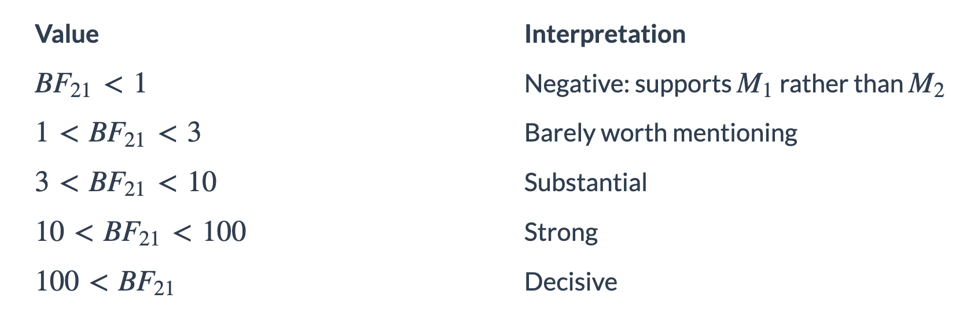
Bayes factors for model comparison

Slide 32
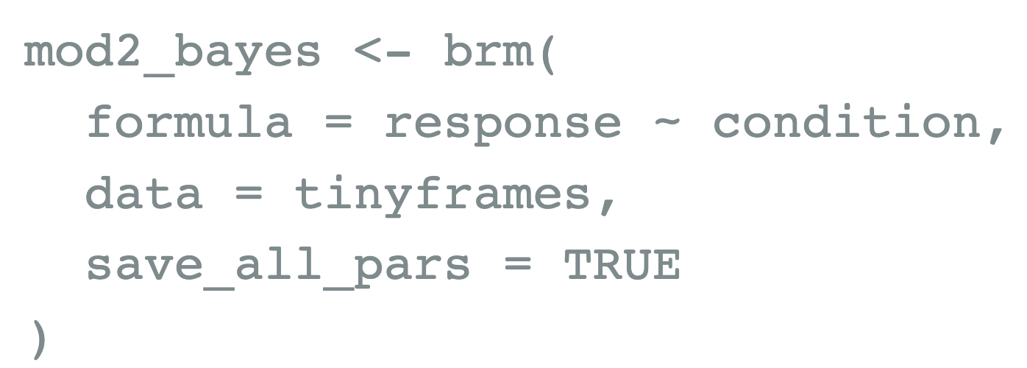
Bayes factors for model comparison
mod1:
mod2:

Slide 33
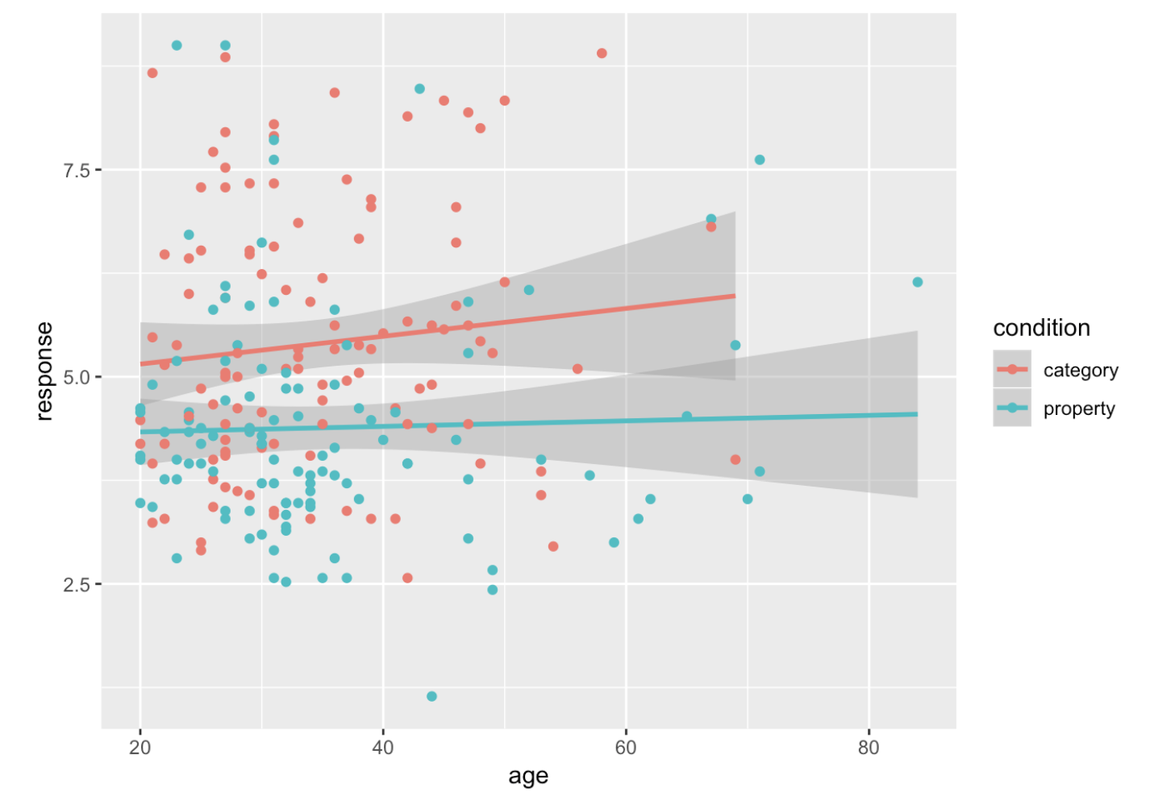
Multiple predictors

Slide 34
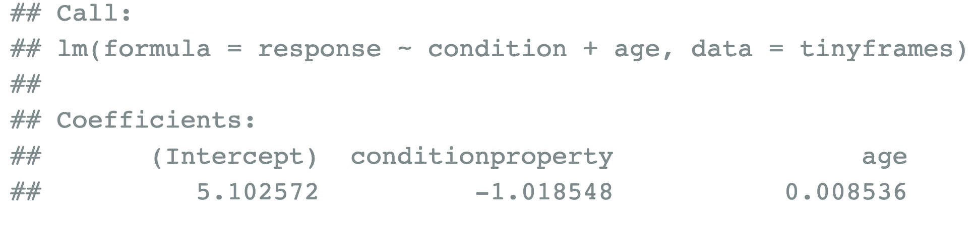
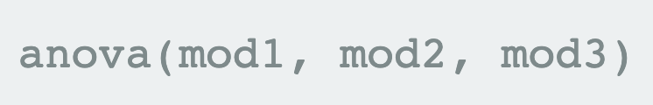
Multiple predictors
mod3:
Model selection:

Slide 35


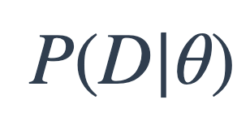
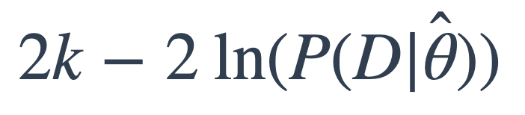
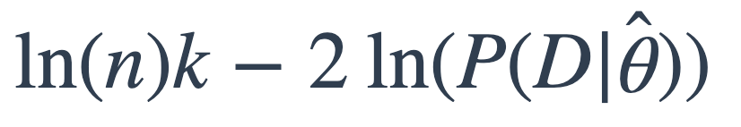
Model comparison with AIC and BIC
For model with parameters
Find that maximizes
AIC:
BIC:
where k is number of parameters,
n is number of data points

Slide 36
Model comparison with AIC and BIC
Find that maximizes
AIC:
BIC:
where k is number of parameters,
n is number of data points
Important points:
- lower is better
- both penalize model complexity (BIC has heavier penalty)

Slide 37
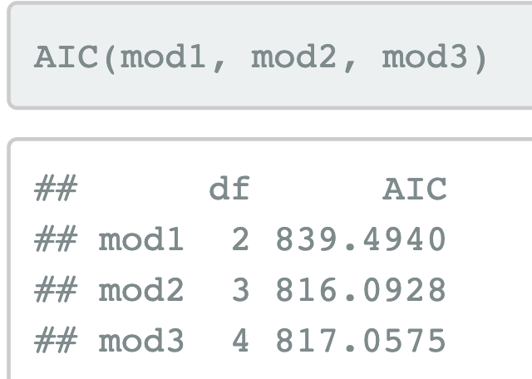
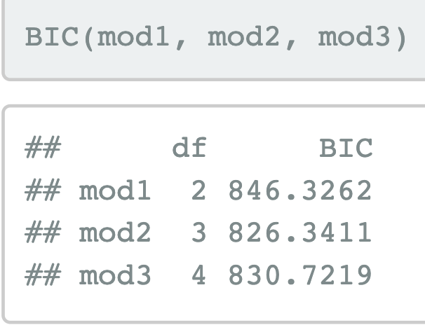
Model comparison with AIC and BIC

Slide 38
Mixed effects models
ANOVA models used to be the go-to approach in psychology, but the field is shifting to mixed-effects models.
Advantages of mixed-effects models:
extend naturally to complex situations (e.g. cases with nested structure, factors that overlap in complex ways)
deal well with missing data

Slide 39
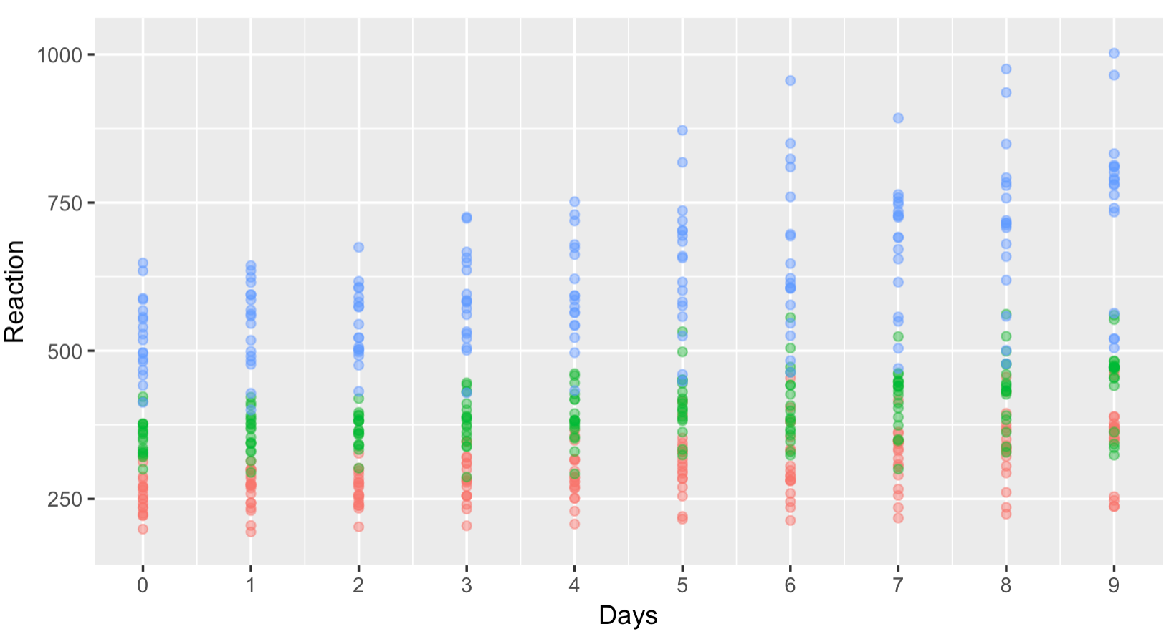

Sleep study example

Slide 40

Fixed intercept, slope

Slide 41

Random intercept per group

Slide 42

Random slope per group

Slide 43

Random slope + intercept per group

Slide 44





Mixed effects models

Slide 45
Exercise

Slide 46


modestframes data

Slide 47

Model comparison
anova(modest1, modest2, modest3)

Slide 48


Model checking: individuals

Slide 49

Model checking: predictions

Slide 50

Model checking: residuals

Slide 51


frames data

Slide 52

Model comparison
linframes1:
linframes2:
anova(linframes1, linframes2)

Slide 53

Model checking: individuals

Slide 54


Generalized linear mixed models
Map response to generalization (between 0 and 1)

Slide 55
What to write up?
The actual paper reported Bayes factors computed using JASP
See analysis_samplesize.Rmd (in samplingframes/analysis) for more

